Slide 1

Level: Advanced – session 10
Game Development with Unity
Omid Saadat

Slide 2
Writing Managed Plugin
What we need:
  Visual studio or MonoDevelop
  UnityEngine.dll
    On windows “C:\Program Files\Unity\Editor\Data\Managed”
  Create a library for DotNetFramework 3.5

Slide 3
workshop
Write a plugin sample in class

Slide 4
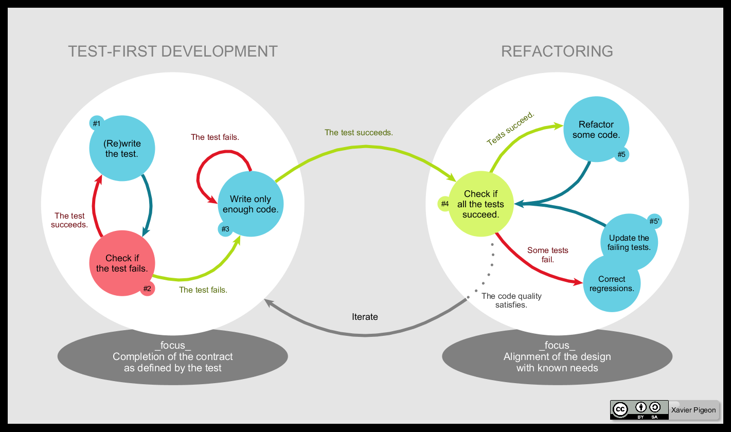
TDD

Slide 5
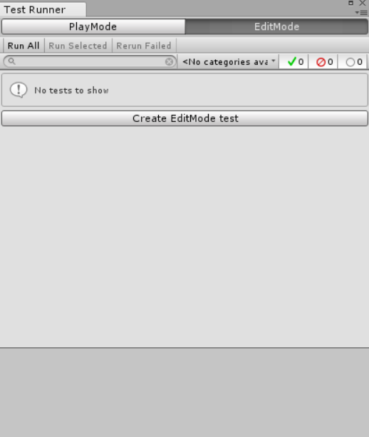
TDD Development
How to write tests in Unity
  Write test class
  Run tests!

Slide 6
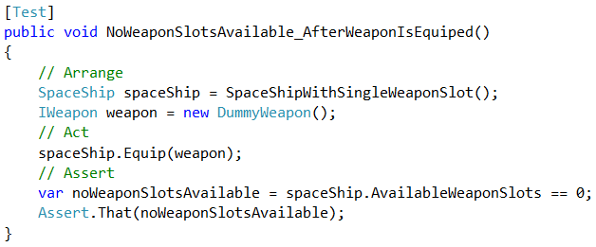
In Unity
[Test] attribute
Class Naming convention
Arrange / Act / Assert

Slide 7
More info
Managed plugin in unity manual
Writing plugin tutorial
Unity blog on TDD

Slide 8
Last words
Tool suggestion
  VsCode with unity extentions
  Git for version control
  Pick your own development framework and make a clean template
  On Windows platform:
    Launchy
    Search everything
    Greenshot
    DirectFolder

Slide 9
Good luck!
I don’t care about reaching or not reaching
Its enough to spend life looking for
در این نیَم که رسد تنْ به وصل یا نرسد
همین‌ که عُمر شود صرفِ جست‌وجو کافی‌ست.
حزینِ لاهیجی
Hazin Lahiji

